Slide 1

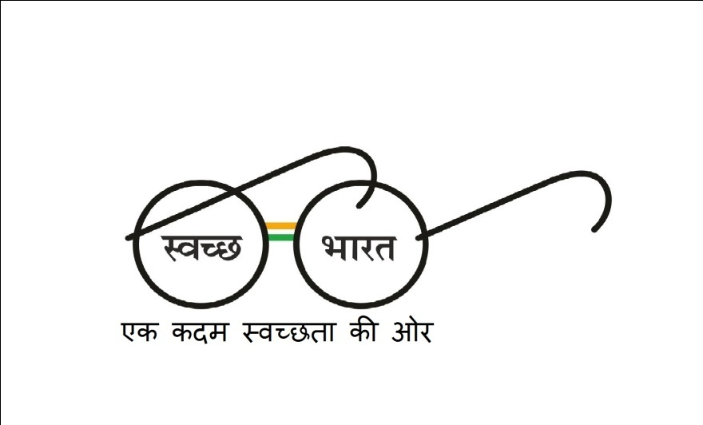
MUNICIPALITY AWARENESS PROGRAM
A step towards Swachh Bharat……….

Slide 2
INTRODUCTION
Our project deals through waste management solution to the problem prevailing in our city.
As we all know that the city’s MUNICIPAL CORPORATION works day and night by roaming the city unnecessarily without knowing where to take sudden actions. Same goes with us as well. We do not know who to contact or how to bring to the Co. mind where actions have to be taken.
So through our project we will be providing a medium(WEBSITE & an Android-APP) between user and municipality, through which each citizen of the city can take the initiative by informing which place has to be cleaned, roads to be repaired, filling of the pot holes, electricity wire break down, etc. Here one has to take the snap of the above mentioned problem and also share the real time location of it, for the convenience of the municipality. Through this municipality can easily track the shared locations and take sudden actions wherever required.

Slide 3
ABOUT THE APP
Municipality Awareness Program is an Android based application. As the app opens the user has the option to continue to the next page. The next page will ask the user to agree for the Terms And Condition. If the user agrees then the user will be redirected to the next page where the user has to enter his details. The details will comprise following things:-
Enter your name
Enter your mobile number
Enter your Email Id
Select your issue ( Waste issue, Water issue, Road issue or Electricity issue)
Give details of the issue
Upload image
Add location
Submit
After the successful submission, the issue will be directed to the municipality server and rectify the problem as and when required.

Slide 4
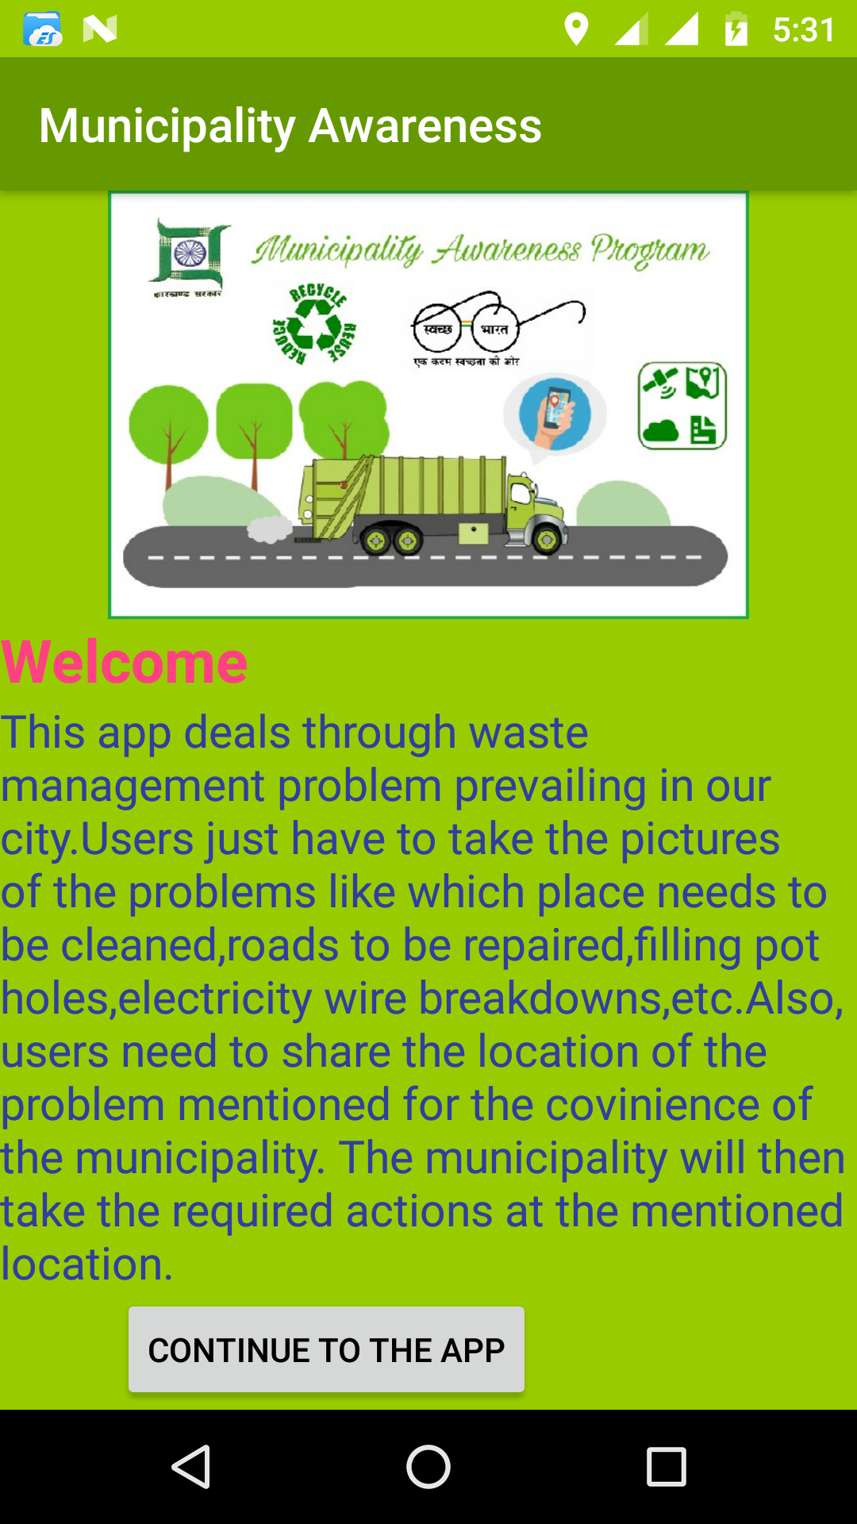
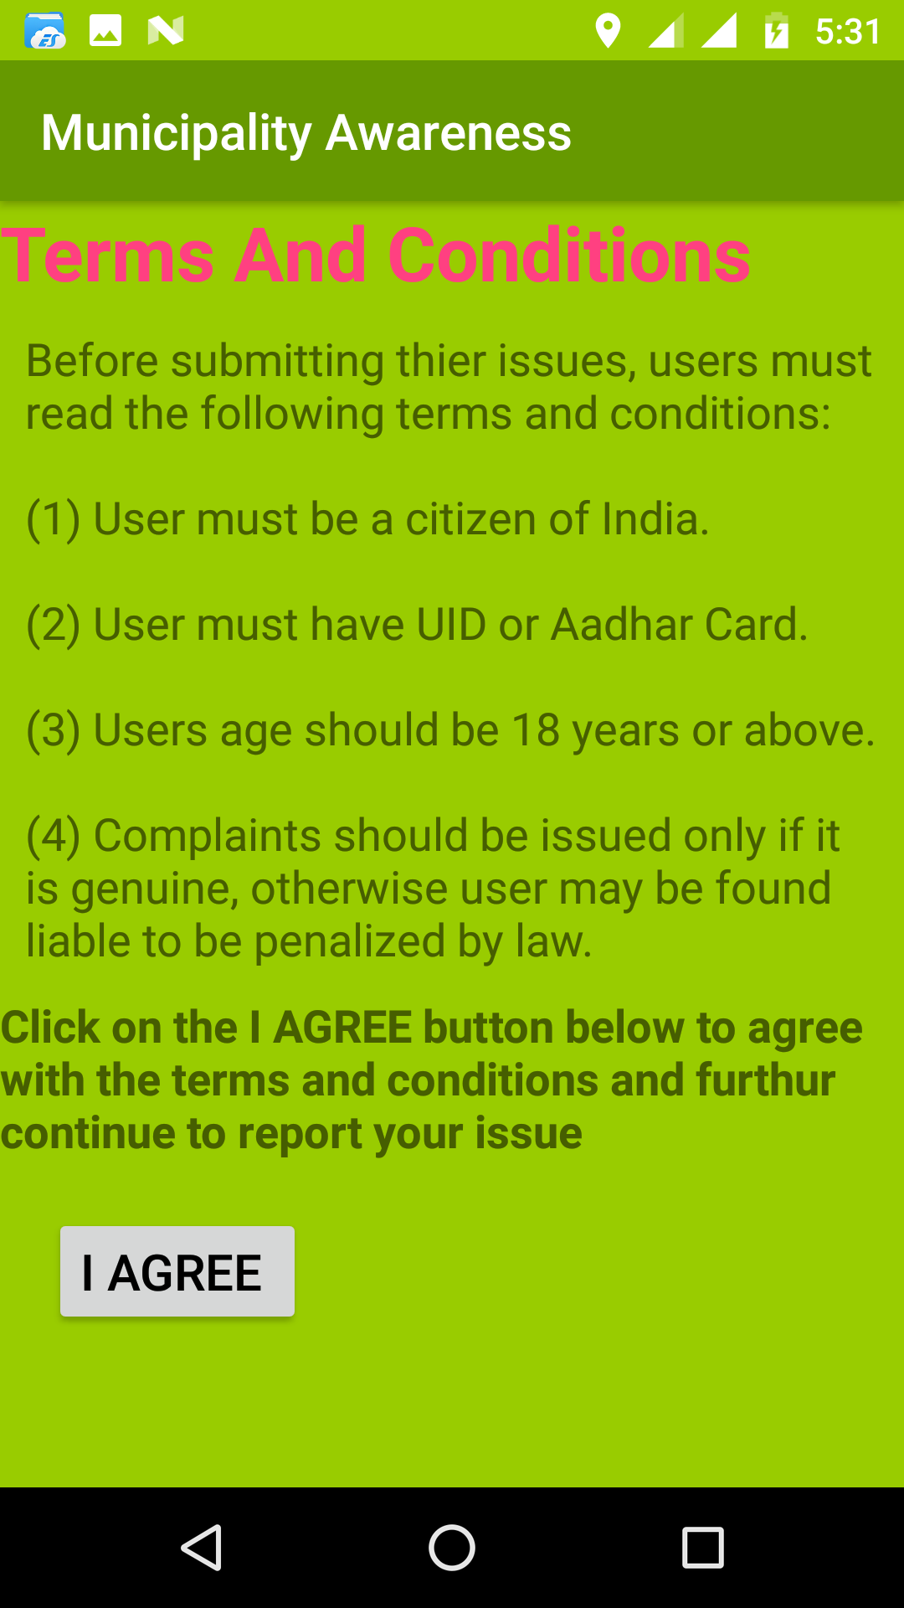
STEP 1
STEP 2

Slide 5
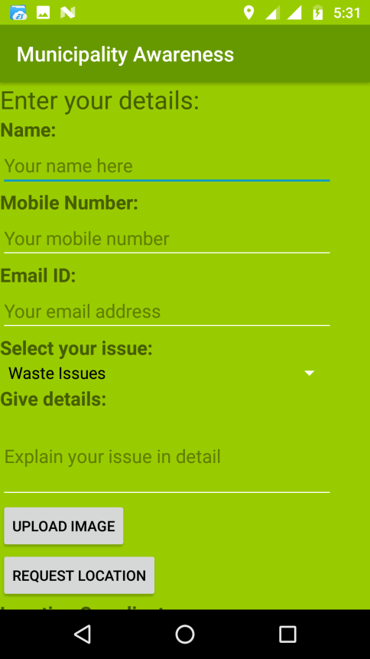
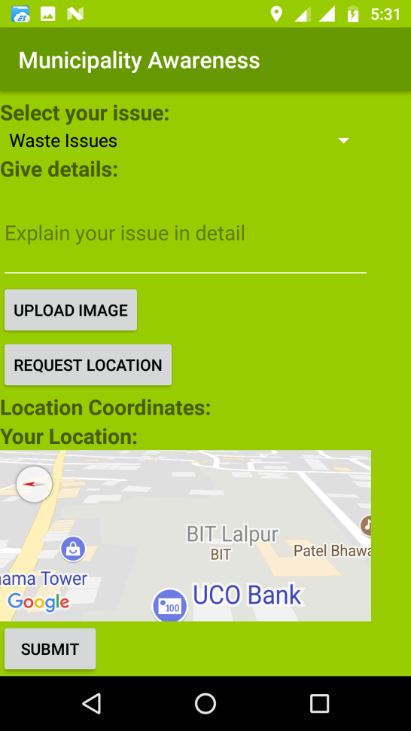
STEP 3
STEP 4

Slide 6
ABOUT THE WEBSITE
There is also a provision to access our application through website. The website will be helpful for those users who cannot access the mobile application. This also works in the same way as app does. Here the user has to visit the website. There will be a separate complaint form provided in the website where user has to fill in the details consisting of following details:
User’s Name
Phone No
Aadhar No
Select your Issue( Waste issue, Water issue, Road issue or Electricity issue)
Sex
Pickup Date & Time (if required)
Upload the relevant photo
Special Instructions
Submit

Slide 7
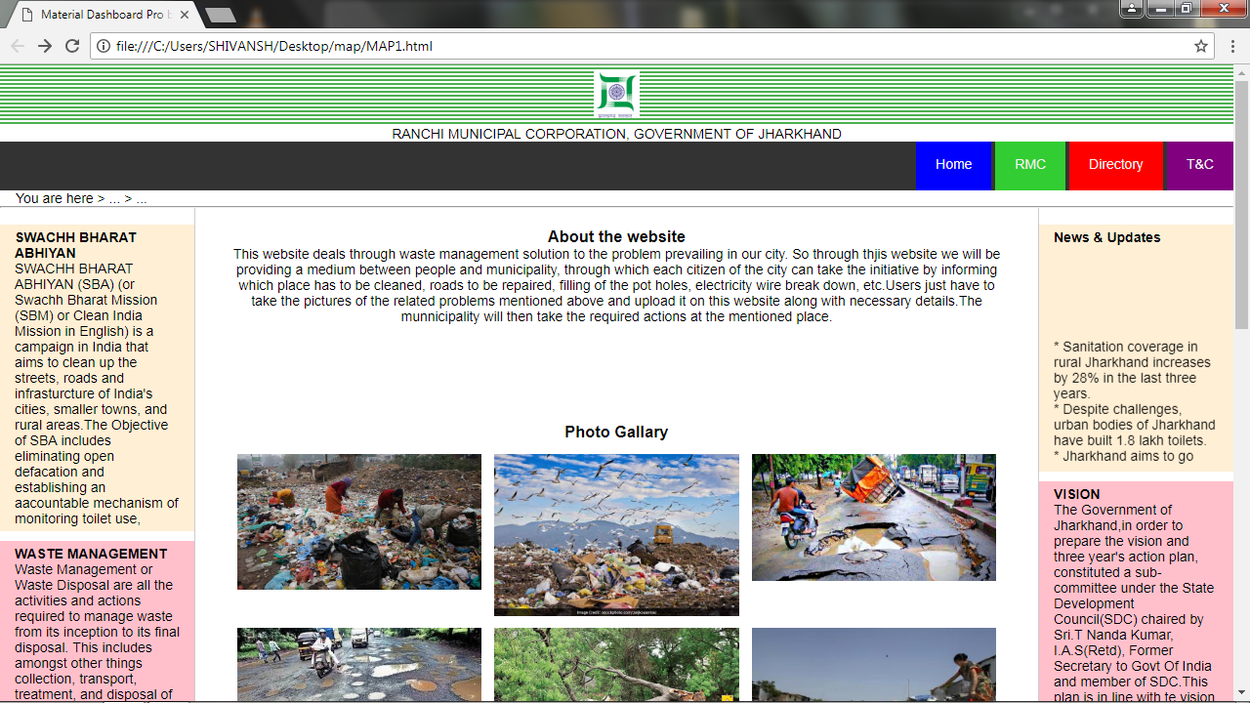
WEBSITE LAYOUT 1

Slide 8
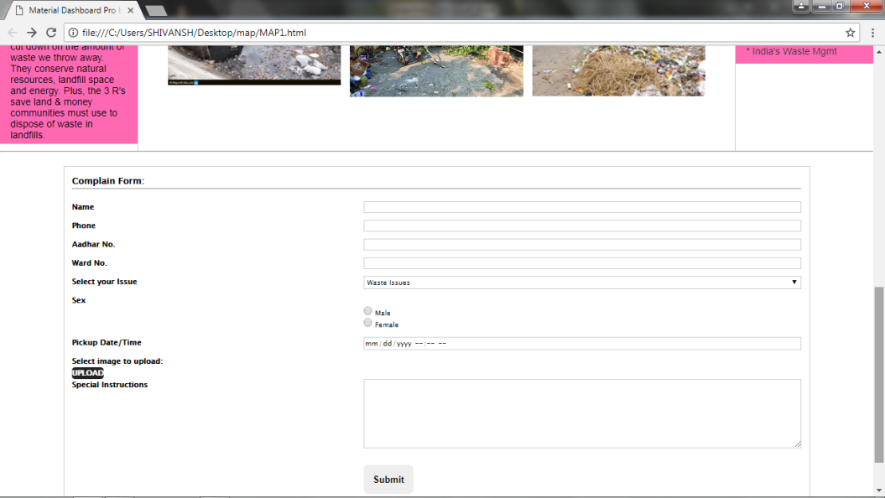
WEBSITE LAYOUT 2 (Complain Box)

Slide 9
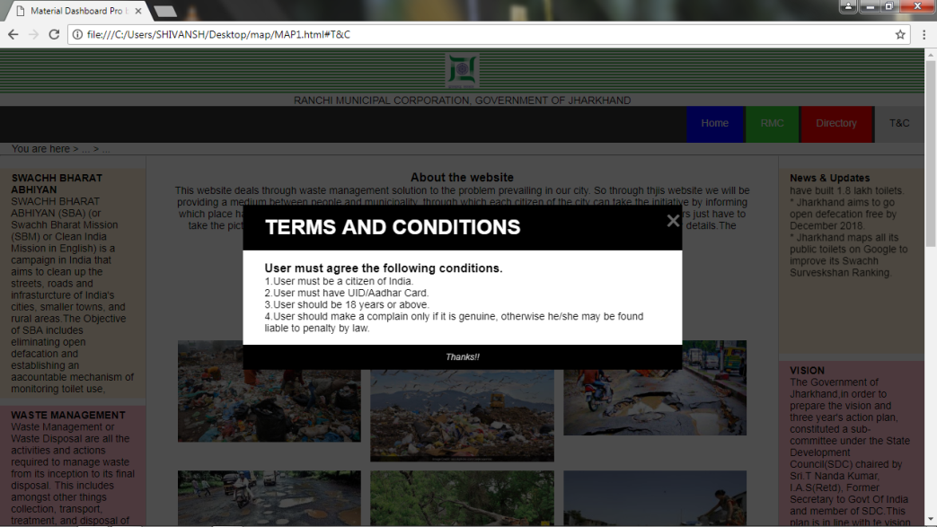
WEBSITE LAYOUT 3 (Terms & Conditions)

Slide 10
SYSTEM SPECIFICATION HARDWARE REQUIREMENTS (At Minimum) Processor: Intel i5 3rd Gen Hark Disk : 500 GB HDD Ram : 4 GB Android Phone version 5.0 & above SOFTWARE SPECIFICATION Operating System : Windows 8 & above Android Studio IDE Software to be used: (Notepad/Notepad++, HTML, CSS, JSP, JAVA Script)

Slide 11
FUTURE SCOPE There have been numerous cases of errors in content and security lapses reported. So in the near future the so-called software could be made more secure and reliable. While smart phones are easily available, instant actions could be taken. So the application has a wide future scope and chance to be accepted by the people for the betterment of society. So this application can be used with much dependency so as to provide a medium between Municipality and citizen of our country. CONCLUSION Municipality awareness program is app based as well as website based application. The website for the project is made using HTML and CSS. The coding of the Application is programmed using Android Studio (IDE). Our project deals through waste management solution to the problem prevailing in our city. So through our project we will be providing a medium (WEBSITE & an APP) between users and the municipality. It will help to keep or city clean and problem free.

